Slide 1

How to Log in to Witsapps as a Guest
Notes:
Everything you need to know is at www.wits.ac.za

Slide 2
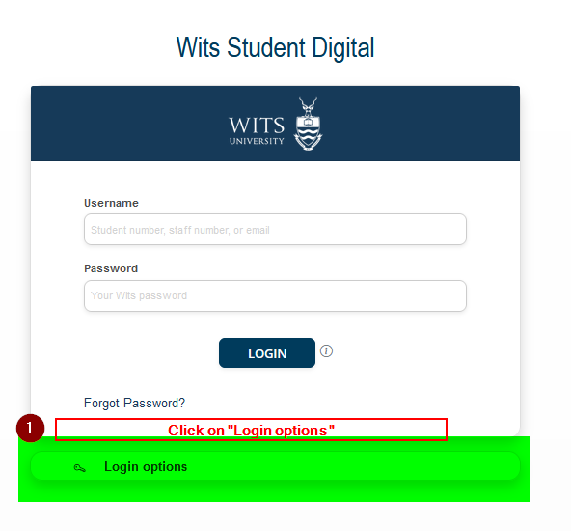
Access
Notes:
Wits Video: [WATCH] a quick overview of Wits University, with music and subtitles.

Slide 3
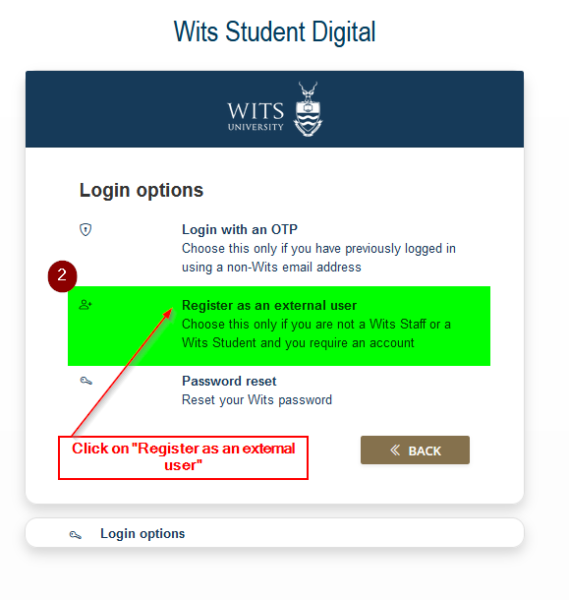
Register
Notes:
Wits Video: [WATCH] a quick overview of Wits University, with music and subtitles.

Slide 4
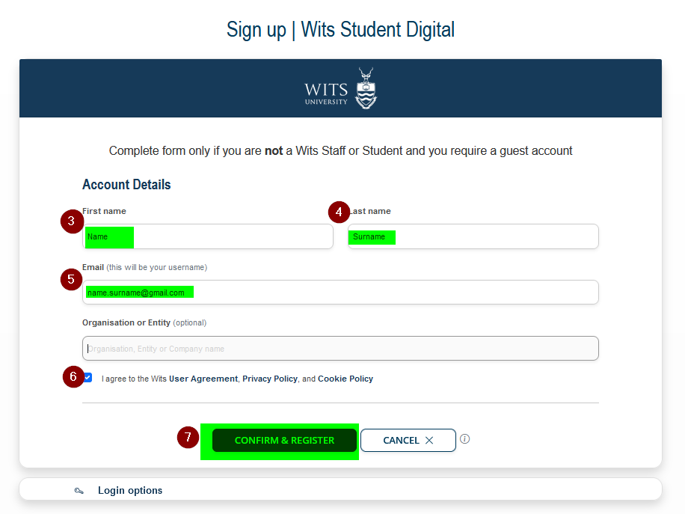
Fill-in details
Notes:
Wits Video: [WATCH] a quick overview of Wits University, with music and subtitles.

Slide 5
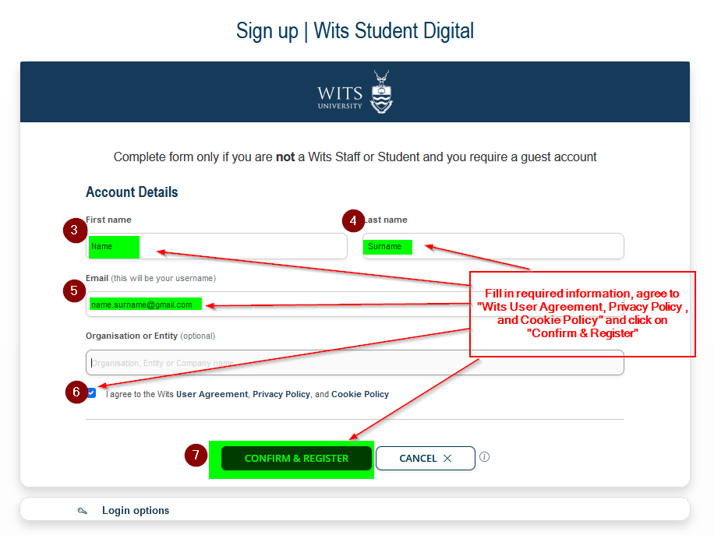
Fill-in details
Notes:
Wits Video: [WATCH] a quick overview of Wits University, with music and subtitles.

Slide 6
Fill-in details
Notes:
Wits Video: [WATCH] a quick overview of Wits University, with music and subtitles.

Slide 7
Fill-in details
Notes:
Wits Video: [WATCH] a quick overview of Wits University, with music and subtitles.

Slide 8
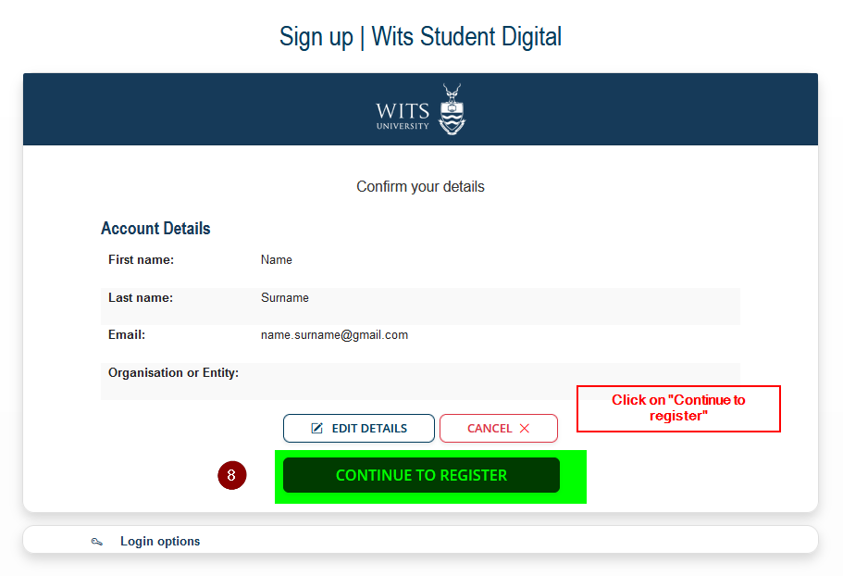
Confirm registration
Notes:
Wits Video: [WATCH] a quick overview of Wits University, with music and subtitles.

Slide 9
Confirm registration
Notes:
Wits Video: [WATCH] a quick overview of Wits University, with music and subtitles.

Slide 10
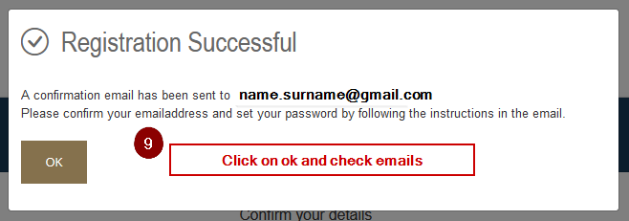
Success
Notes:
Wits Video: [WATCH] a quick overview of Wits University, with music and subtitles.

Slide 11
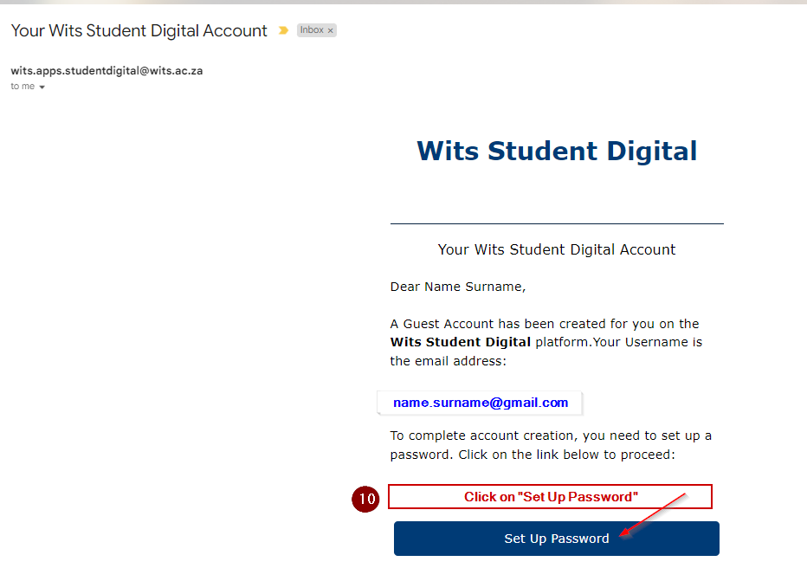
Success
Notes:
Wits Video: [WATCH] a quick overview of Wits University, with music and subtitles.

Slide 12
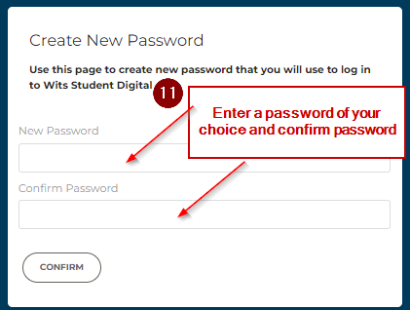
Success
Notes:
Wits Video: [WATCH] a quick overview of Wits University, with music and subtitles.

Slide 13
Success
Notes:
Wits Video: [WATCH] a quick overview of Wits University, with music and subtitles.

Slide 14
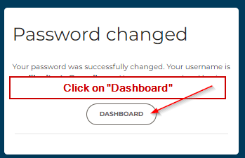
Success
Notes:
Wits Video: [WATCH] a quick overview of Wits University, with music and subtitles.

Slide 15
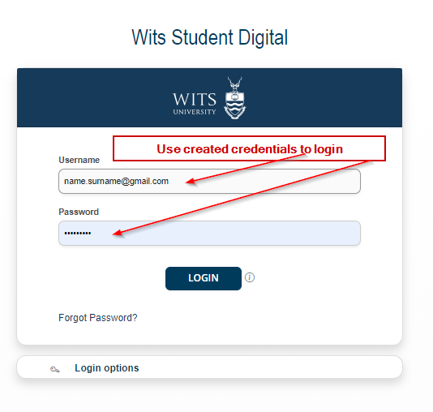
Success
Notes:
Wits Video: [WATCH] a quick overview of Wits University, with music and subtitles.

